Slide 1

A
ARUN RAJ V
PRESENTATION
HOUSING ANALYSIS
Milestone 1

Slide 2

HOUSING ANALYSIS
PROJECT FLOW
Objective
Data Understanding
Data
Cleaning
Conclusion
Charts
Data Visualization

Slide 3

OBJECTIVE
The objective of this EDA is to uncover patterns and trends in real estate data, revealing insights into property features like price, size , and location to support informed decision-making.

Slide 4

DATA UNDERSTANDING
HEAD
TAIL
SHAPE
SIZE
INFO
COLUMNS

Slide 5

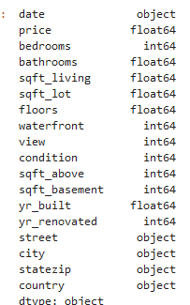
INITIAL EXPLORATION
They are total 18 columns

Slide 6

DATA
CLEANSING
HANDLING MISSING DATA
REMOVING DUPLICATE RECORDS
HANDLING OUTLIERS
CORRECTING DATA TYPES
DERIVED METRICS

Slide 7

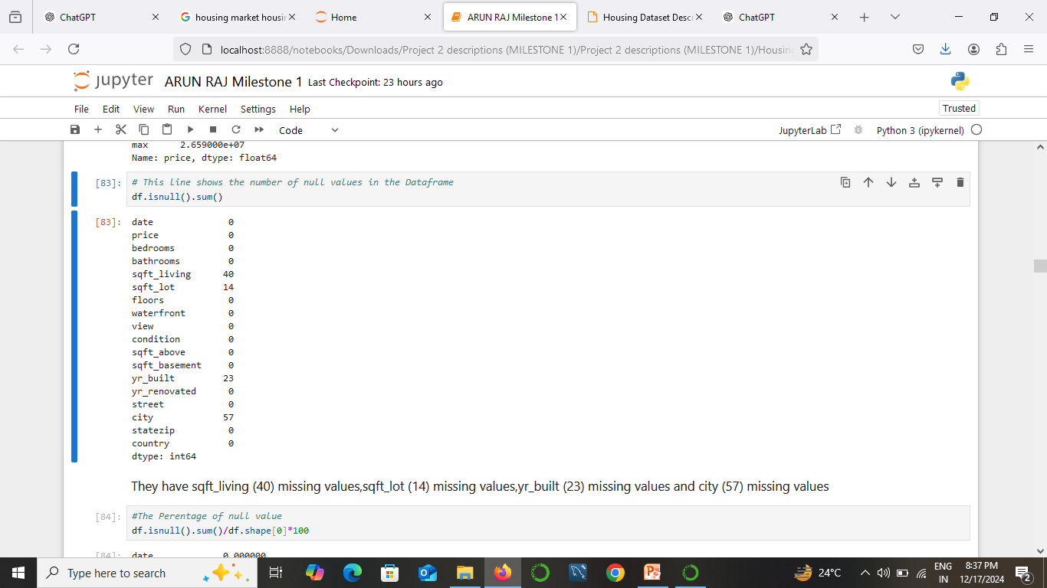
Handling Missing Data
There are 40 missing values in the square feet living column.
There are 14 missing values in the square feet lot column.
There are 23 missing values in the year built column and 57 missing values in the city column.

Slide 8

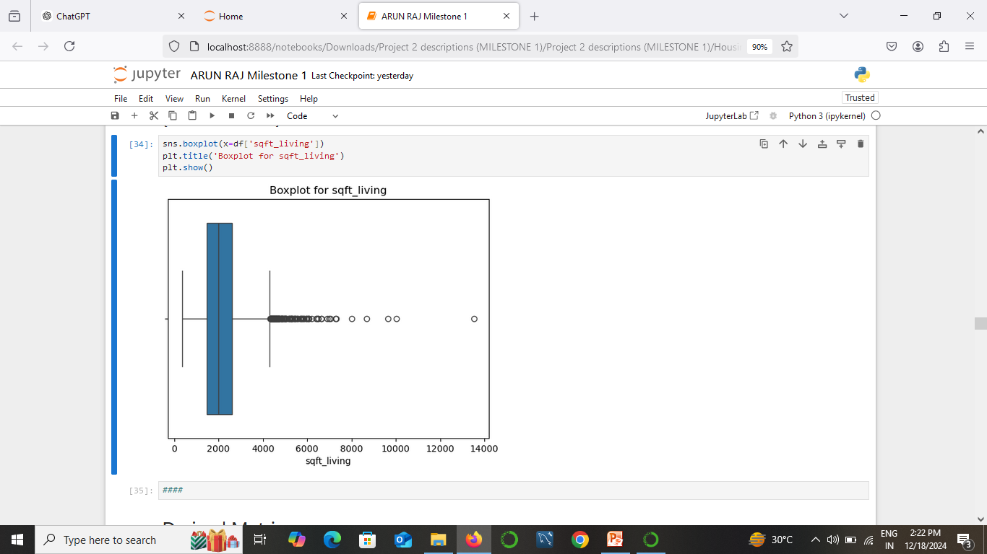
HANDLING OUTLIERS
The majority of
Homes have a living
area between 0 to
2000 square feet
Therefore , the outliers
are values above
4,000 square feet

Slide 9

DERIVED METRICS
Price per square foot for living space
Price per total lot area
Total area including above and basement space
Living area per floor (average per floor)
Bathroom-to-bedroom ratio

Slide 10

DATA VISULIZATION
UNIVARIATE ANALYSIS
BIVARIATE ANALYSIS
MULTIVARIATE ANALYSIS

Slide 11

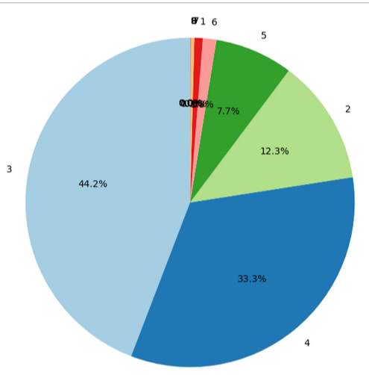
UNIVARIATE ANALYSIS
44.2% of the data falls into the "3 Bedrooms" category.
33.3% falls into the "4 Bedrooms" category.
12.3% is in the "2 Bedrooms" category.
7.7% is in the "1 Bedroom" category.

Slide 12

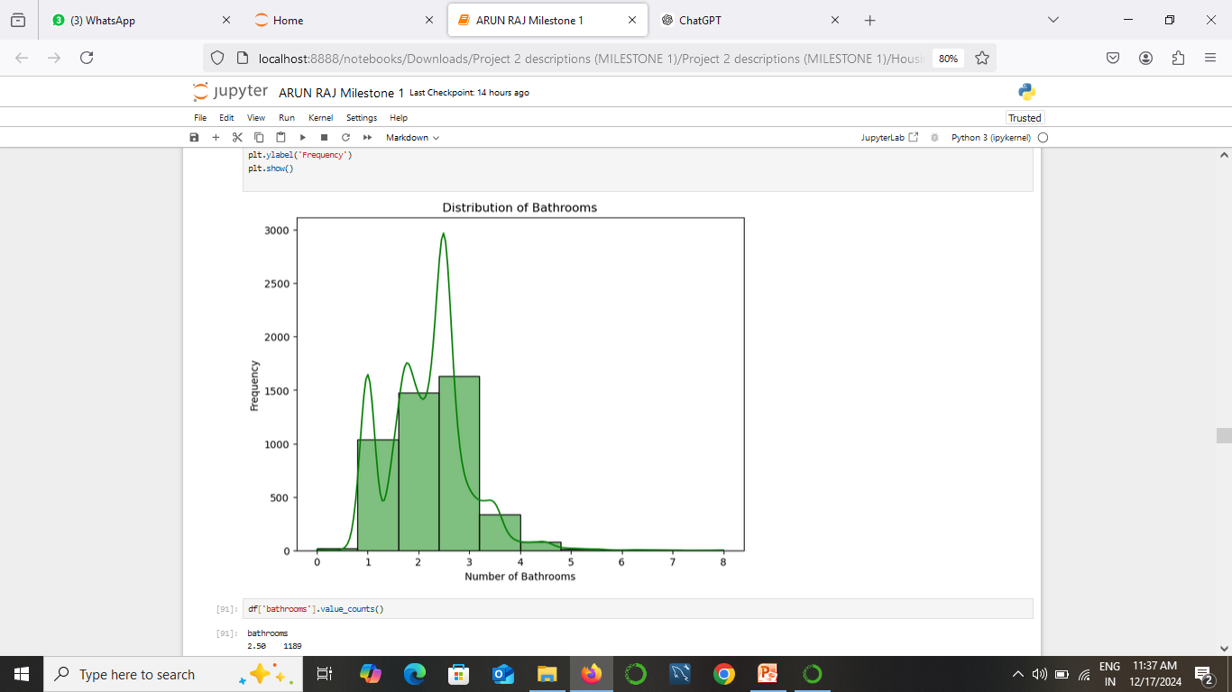
The distribution is skewed to the right.
The majority of properties in the dataset have between 2 and 3 bathrooms.
This suggests that properties with 4 or more bathrooms are less common.

Slide 13

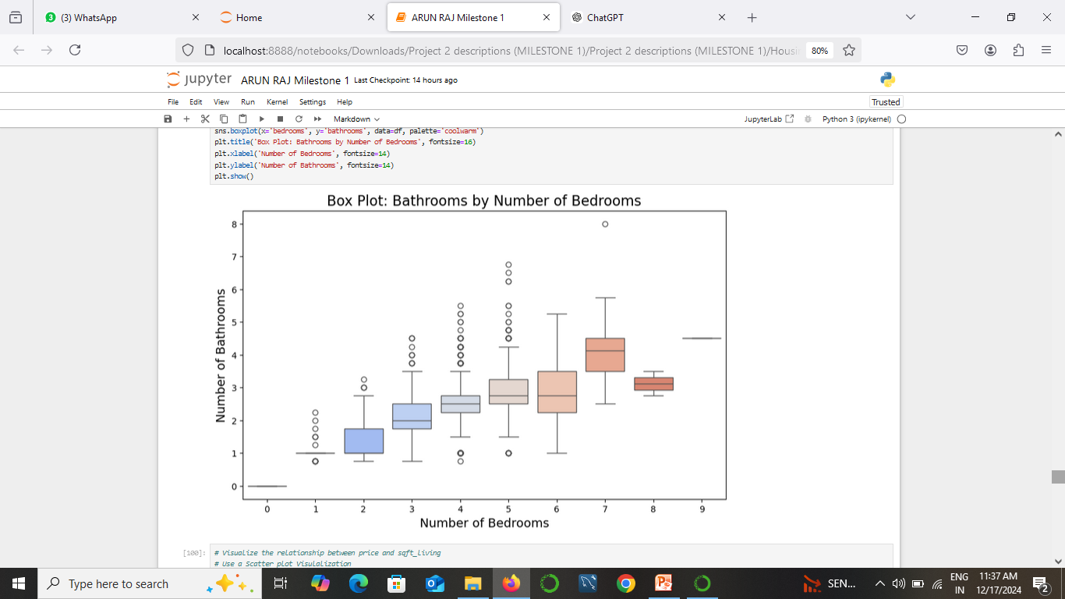
Market Segmentation: This plot could be used to segment the housing market based on the number of bedrooms and bathrooms.
Pricing Strategy: Developers and real estate agents can use this information to price properties competitively.
Design Considerations: Builders can use this to inform the design of new homes, considering the typical number of bathrooms expected for different bedroom counts.

Slide 14

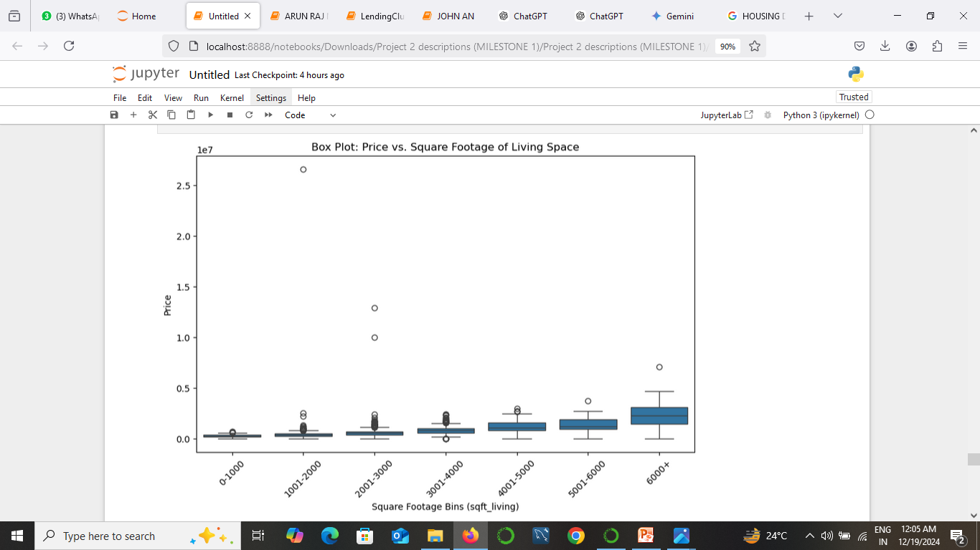
Minimum: The lowest price in the dataset (excluding outliers).
First Quartile (Q1): The price below which 25% of the data falls.
Median (Q2): The middle value of the dataset.
Third Quartile (Q3): The price below which 75% of the data falls.
Maximum: The highest price in the dataset (excluding outliers).

Slide 15

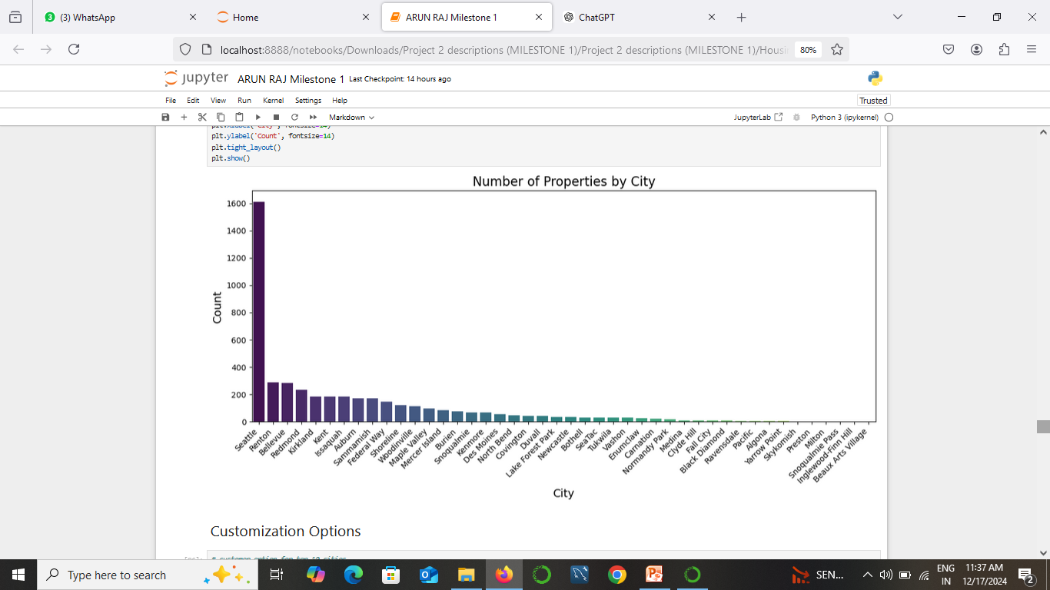
SEATTLE is a top cities number in the data set , due to its larger population, economic activity, and desirability as a place to live.
RENTON is second cities of the data set

Slide 16

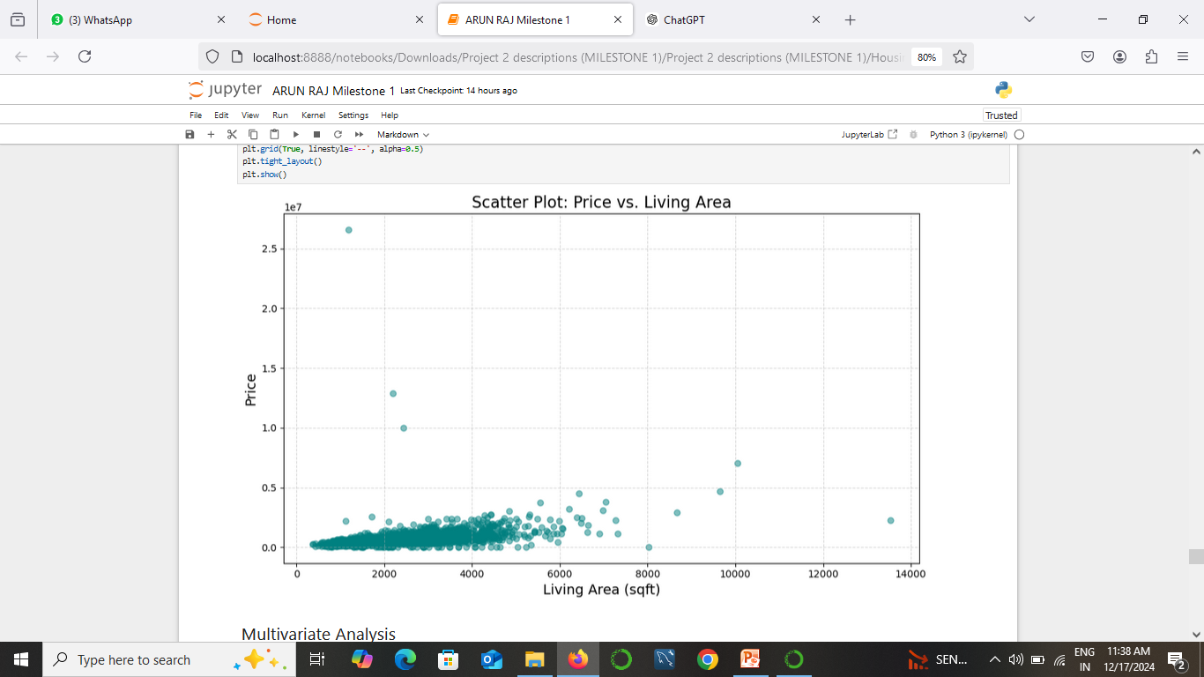
Living Area as a Price Factor: Living area is likely a significant factor influencing the price of a property. Larger properties tend to be more expensive.
Other Factors: While living area is a strong predictor, other factors like location, amenities, and property condition also play a role in determining the price.

Slide 17

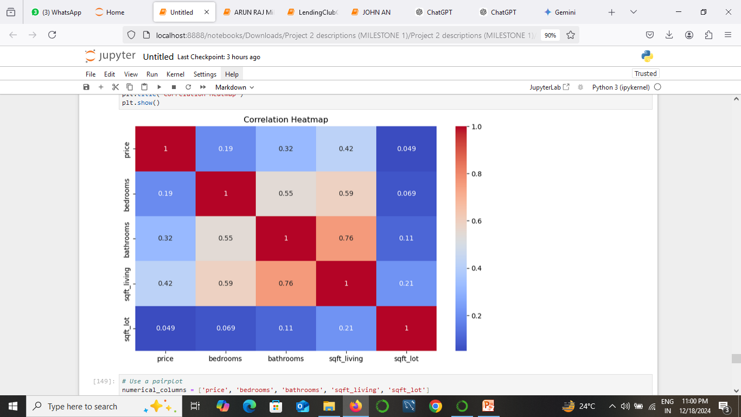
Each cell in the heat map represents the correlation coefficient between two variables. Correlation coefficients range from -1 to 1

Slide 18

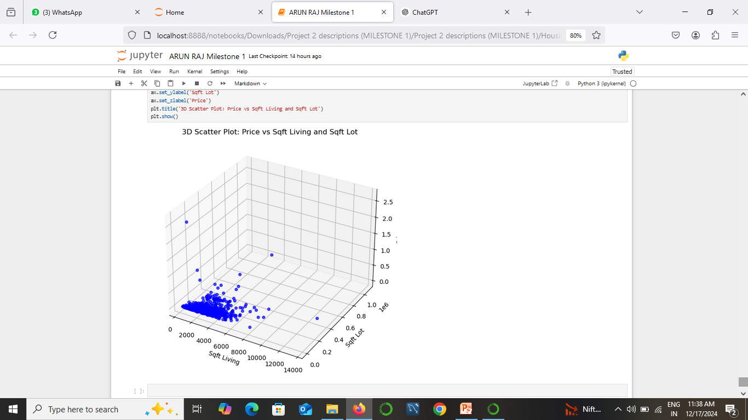
House prices tend to increase with both "Sqft Living" and "Sqft Lot," showing a positive correlation.
w luxury homes or large properties are present with significantly larger living spaces and lot sizes.

Slide 19

CONCLUSION
The housing data analysis project provides significant insights into the key factors influencing property prices and other aspects of the real estate market.

Slide 20

THANK YOU
Create your dream home beautifully

